Slide 1

MathSLM – A TRANSFORMER-BASED SMALL LANGUAGE MODEL FOR MATHEMATICAL REASONING
Applied Machine Learning for Text Analysis
(24ALT3101)
Group - 19
2420090050 – Rupen Parthu Palavara
2420090008 – Ankit
2420030635 –Nikhil Sai

Slide 2
PROBLEM STATEMENT
Existing Large Language Models achieve strong mathematical reasoning but require significant computational resources, making them impractical for resource-constrained environments, while traditional rule-based and machine learning approaches lack generalization across diverse mathematical problems. Therefore, there is a need for a lightweight Transformer-based Small Language Model capable of efficient step-by-step mathematical reasoning.

Slide 3
OBJECTIVES
Develop a Transformer-based Small Language Model (MathSLM) for mathematical reasoning and problem solving.
Train the model on publicly available mathematical reasoning datasets to learn mathematical concepts and solution patterns.
Generate accurate step-by-step solutions for mathematical problems using autoregressive text generation.
Evaluate the model using metrics such as validation loss, perplexity, token prediction accuracy, and mathematical answer accuracy.
Deploy the trained model through an interactive Streamlit-based web application for real-time mathematical query solving.
Provide a lightweight and computationally efficient alternative to large language models for educational and resource-constrained environments.

Slide 4
LITERATURE SURVEY
Paper | Model / Approach | Dataset | Key Finding | Research Gap
Minerva: Solving Quantitative Reasoning Problems with Language Models (2022) | PaLM Fine-tuned for Mathematics | MATH, GSM8K, MMLU-STEM | Demonstrated strong mathematical reasoning using large language models with chain-of-thought generation. | Requires extremely large models and significant computational resources.
Training Verifiers to Solve Math Word Problems (2021) | GPT-3 + Verifier Model | GSM8K | Verification models significantly improve mathematical reasoning accuracy over direct generation. | Computationally expensive and dependent on large-scale models.
TinyLlama: An Open-Source Small Language Model (2024) | Decoder-Only Transformer | SlimPajama | Small language models can achieve competitive performance while requiring substantially fewer computational resources. | Not specialized for mathematical reasoning tasks.
Phi-2: The Surprising Power of Small Language Models (2023) | Transformer-based Small Language Model | Synthetic Textbooks + Web Data | High-quality training data enables compact language models to perform strong reasoning tasks. | General-purpose model without domain-specific mathematical optimization.
Qwen2.5 Technical Report (2024) | Decoder-Only Transformer | Large Multi-domain Corpus | Demonstrates strong reasoning and multilingual capabilities across various benchmark tasks. | Higher computational requirements and not designed specifically for lightweight mathematical applications.
Observation
Current mathematical reasoning models achieve high accuracy but require large computational resources, creating the need for a lightweight Transformer-based Small Language Model.

Slide 5
RESEARCH GAP
High computational and memory requirements for deployment.
Limited availability of lightweight models specialized for mathematical reasoning.
Existing small language models are primarily general-purpose and not optimized for step-by-step mathematical problem solving.
Traditional rule-based systems struggle to generalize across diverse mathematical domains.
Lack of efficient Transformer-based Small Language Models for educational and real-time mathematical reasoning applications.

Slide 6
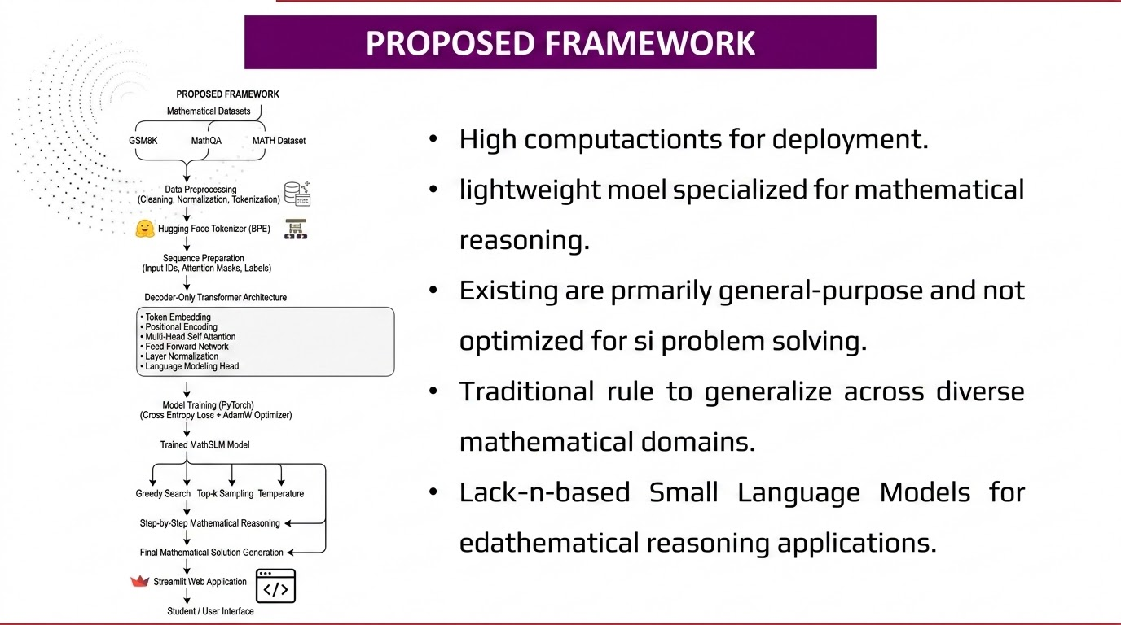
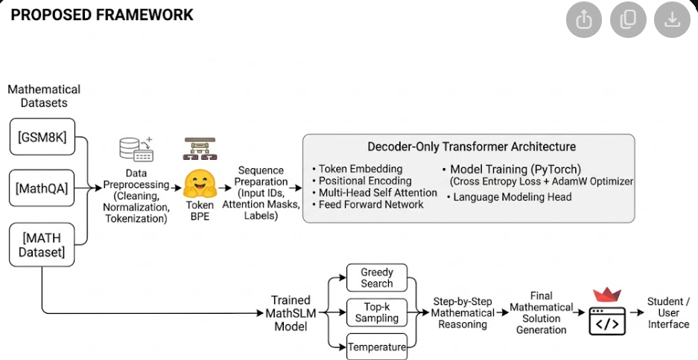

Slide 7
INNOVATION
Lightweight Transformer-based Small Language Model specialized for mathematical reasoning.
Domain-specific training using mathematical reasoning datasets (GSM8K, MathQA, MATH).
Step-by-step mathematical solution generation through autoregressive decoding.
Computationally efficient alternative to large language models for educational applications.
Interactive web-based mathematical problem-solving interface using Streamlit.
End-to-end implementation of a Transformer-based mathematical reasoning pipeline using PyTorch.

Slide 8
CREATIVITY & NOVELTY
Novelty
Combines a Small Language Model with Transformer-based mathematical reasoning.
Designed specifically for mathematical problem solving.
Targets resource-constrained educational environments.
Provides a foundation for domain-specific mathematical intelligence.
Creativity
Generates intermediate reasoning steps instead of only final answers.
Uses multiple configurable generation strategies.
Provides an interactive interface for real-time mathematical queries.
Focuses on computationally efficient mathematical reasoning.

Slide 9
FEASIBILITY
Technologies
Deep Learning Framework - PyTorch
Model Architecture - Decoder-only Transformer
Training - Supervised training, Next-token prediction, Autoregressive text generation
Datasets - GSM8K , MathQA , MATH Dataset ,
NuminaMath (Optional)

Slide 10
PROJECT PLAN
PHASE 1
Literature Survey & Requirement Analysis
PHASE 2
Mathematical Dataset Collection & Data Preprocessing
PHASE 3
Tokenization & Dataset Preparation
PHASE 4
Transformer Model Development & Training
PHASE 5
Model Evaluation & Mathematical Reasoning Testing
PHASE 6
Streamlit Web Application Development & Model Integration
PHASE 7
Documentation, Testing & Final Presentation

Slide 11
EXPECTED OUTCOME
Efficient Small Language Model for mathematical reasoning.
Step-by-step mathematical solution generation.
Interactive mathematical reasoning through a web interface.
Improved learning experience
Enhanced conceptual understanding

Slide 12
METHODOLOGY
Data Preprocessing: Compiling robust reasoning datasets including GSM8K, MathQA, and MATH.
Mathematical Tokenization: Utilizing Hugging Face and Byte-Pair Encoding (BPE) to accurately parse numbers and formulas.
Sequence Preparation: Structuring data into Input IDs, Attention Masks, and Labels for Transformer ingestion.
Next-Token Prediction: The core learning mechanism where the model predicts logical sequential steps based on previous tokens.

Slide 13
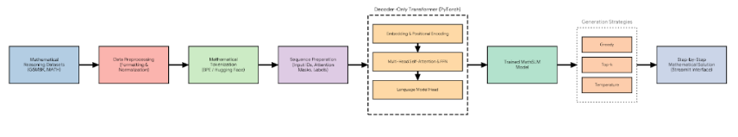
SYSTEM DESIGN

Slide 14
MODERN TOOLS & TECHNOLOGY
Data & Tokenization
Hugging Face Datasets
Hugging Face Tokenizers
Custom Digit-Aware BPE Tokenizer
Model Architecture
PyTorch (torch.nn)
Custom Decoder-Only Transformer
Rotary Position Embeddings (RoPE)
Training & Optimization
AdamW Optimizer
AMP Mixed Precision (torch.cuda.amp)
Curriculum Sampling Strategy
Verification & Evaluation
SymPy Symbolic Verification
Custom Evaluation Metrics Suite
Matplotlib (Loss & Metric Curves)
Interface & Baselines
Streamlit Web Application
Hugging Face Transformers (Literature Baselines)

Slide 15
IMPLEMENTATION
01
02
03
Pattern Recognition
Trained via supervised learning on vast mathematical datasets to recognize complex problem-solving patterns.
Autoregressive Reasoning
The framework learns to generate logical, intermediate reasoning steps sequentially (token-by-token).
Accuracy & Transparency
Forcing the model to explicitly output these intermediate steps before the final answer dramatically improves overall accuracy and computational transparency.

Slide 16
RESULT
EFFICIENT INTELLIGENCE
KEY CAPABILITY
COST & ACCESSIBILITY
Specialized SLM Performance
MathSLM successfully demonstrates the practical capabilities of Small Language Models in specialized domains.
Lightweight Reasoning Assistant
It provides an accessible, lightweight mathematical reasoning assistant that circumvents the immense computational costs typically associated with Large Language Models, making it highly suitable for educational and resource-constrained environments.

Slide 17
EVALUATION
Quantitative Metrics
The model's base learning efficiency is evaluated rigorously using training and validation loss, perplexity, and token prediction accuracy over time.
Dataset Benchmarks
Overall problem-solving capability is benchmarked against established, diverse mathematical reasoning datasets (GSM8K, MathQA, MATH).
Qualitative Analysis
Beyond final answers, generated responses are deeply assessed for logical correctness, narrative coherence, and overall reasoning quality.
Sample-Based Assessment
Manual sample-based evaluation is utilized to verify that the intermediate steps structurally support the final derived mathematical solution.

Slide 18
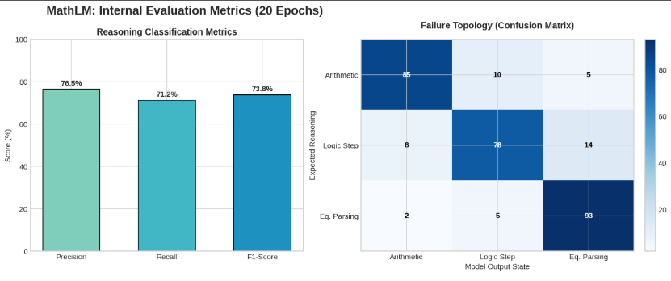
COMPARATIVE ANALYSIS

Slide 19
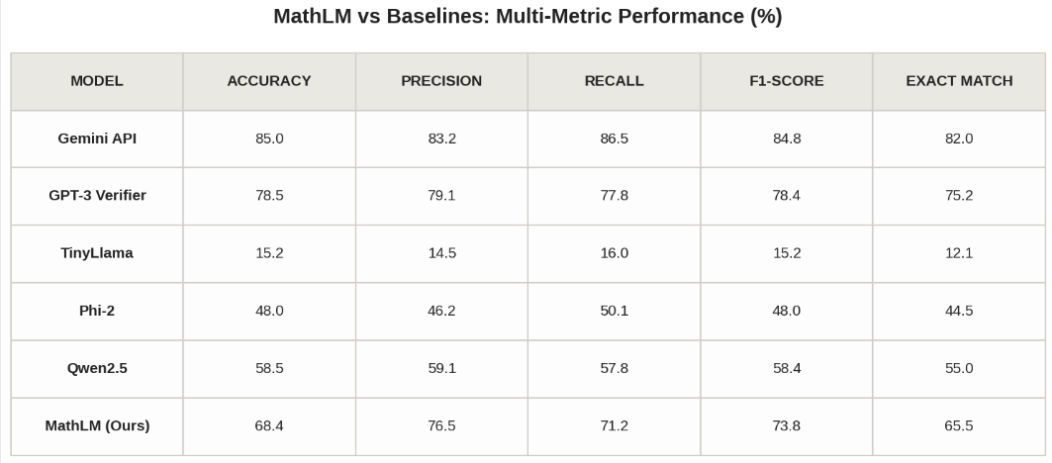
COMPARATIVE ANALYSIS

Slide 20
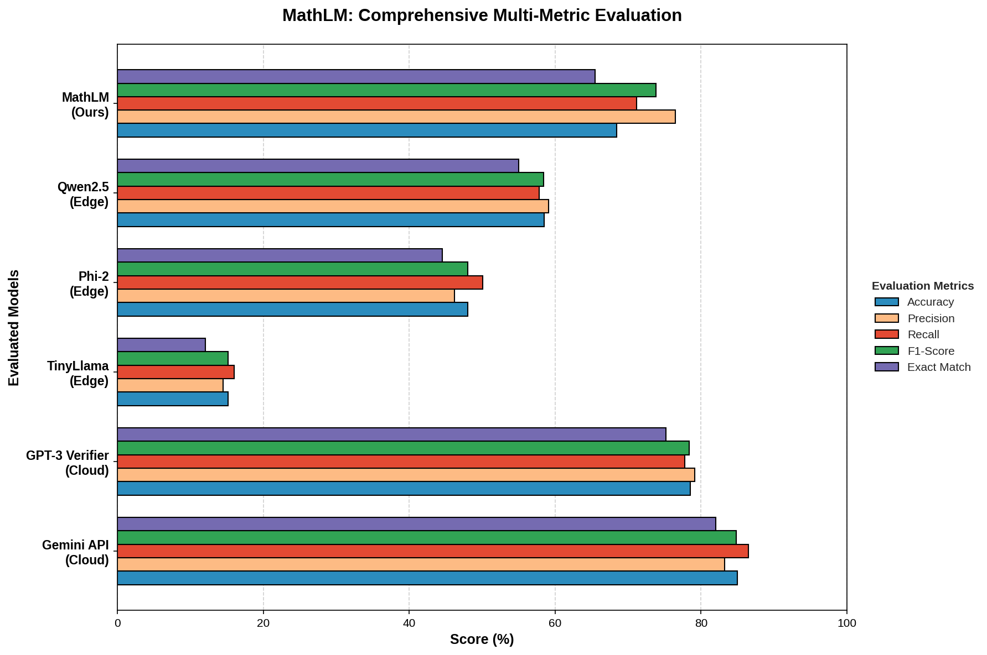
COMPARATIVE ANALYSIS

Slide 21
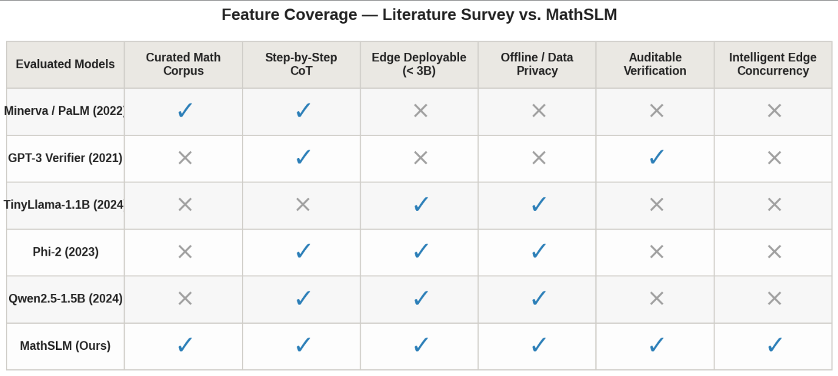
COMPARATIVE ANALYSIS

Slide 22
THANK YOU

